Slide 1



Green Leaf
Prepared by: Vijay Vaghela-19125059
Gautam Shah-19125060
In_House_Project_Review-3

Slide 2
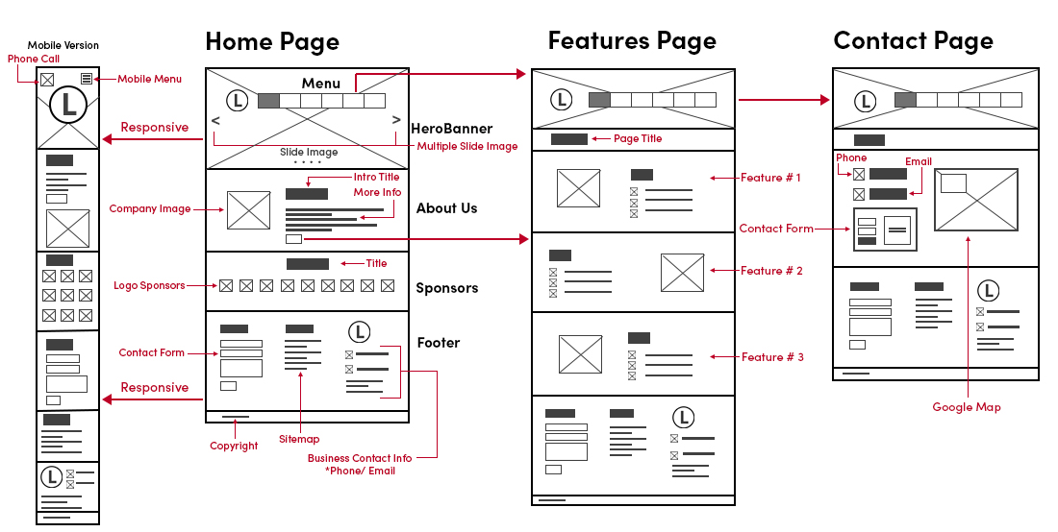
TASK 1: Project Schematic/ Wireframes

Slide 3

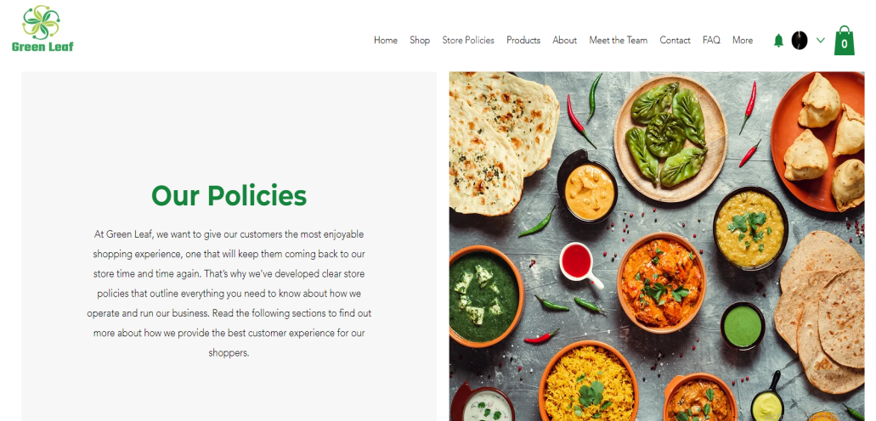
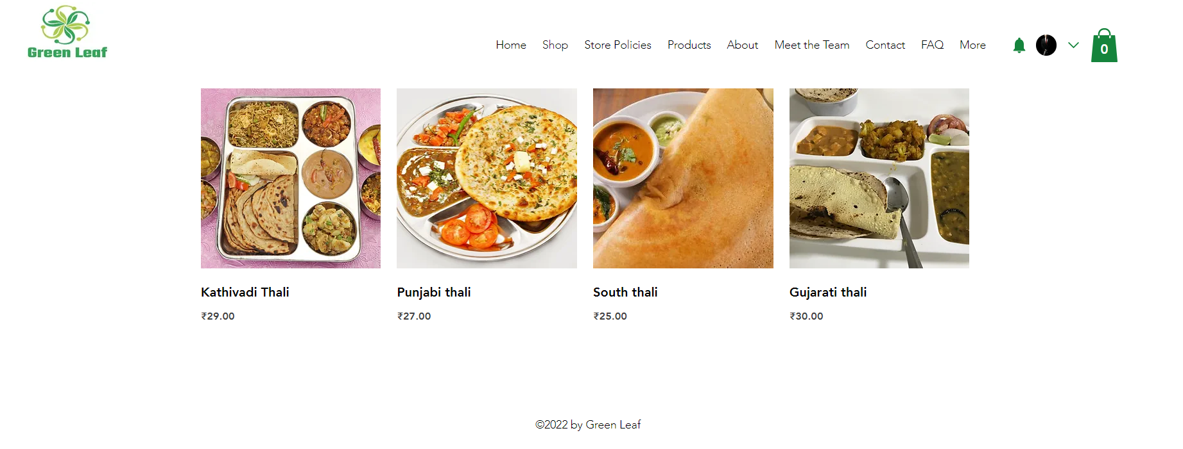
TASK 2: Circuit Design/Initial UI-UX or Database development:

Slide 4

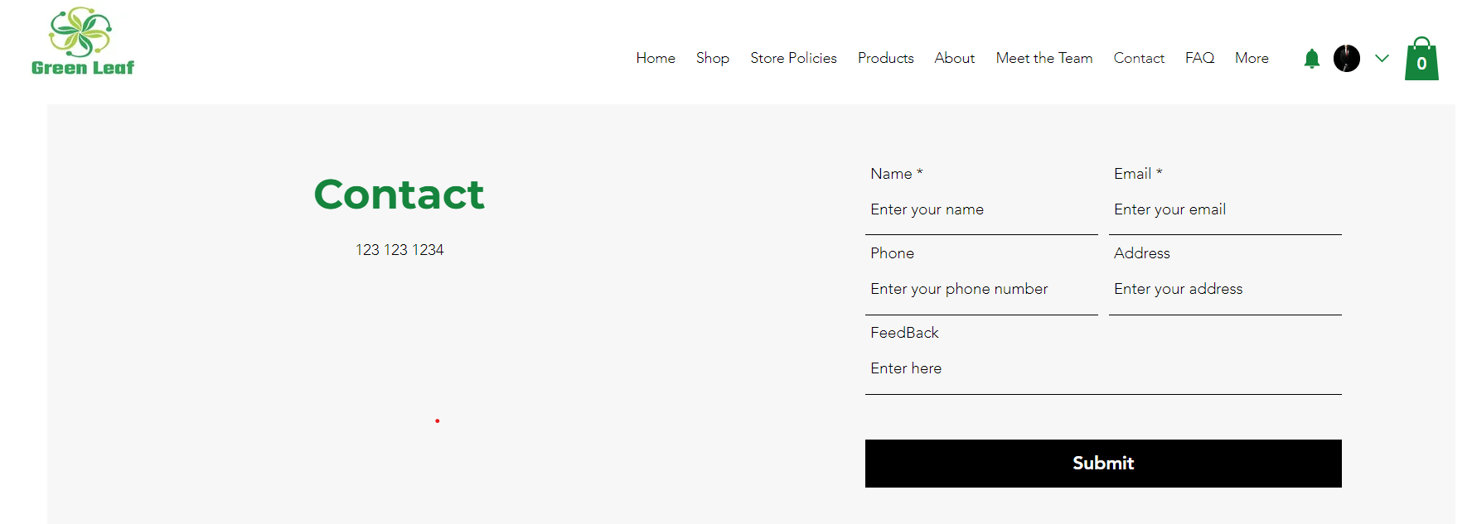

Slide 5
Database development:
Backend Implementation using this framework they are as follow express. js, Django, Ruby on Rails & the list goes on. This can be used as a backend frameworks need an environment conducive to work.

Slide 6
TASK 3: Specifications
Fast, stable & secure web hosting
Highly-responsive mobile site
User-friendly web design
Fast checkout process
Transparent brand information pages
SEO-friendly web pages
Low shipping fee
Integration with a digital advertising service
Blogs

Slide 7
Thank You

